Slide 1
OWASP Cornucopia
Ecommerce Website Edition
OWASP Cornucopia - Ecommerce Website Edition helps developers identify security requirements from the OWASP Secure Coding Practices - Quick Reference Guide
Colin Watson
Watson Hall Ltd
London, United Kingdom
https://www.watsonhall.com

Slide 2
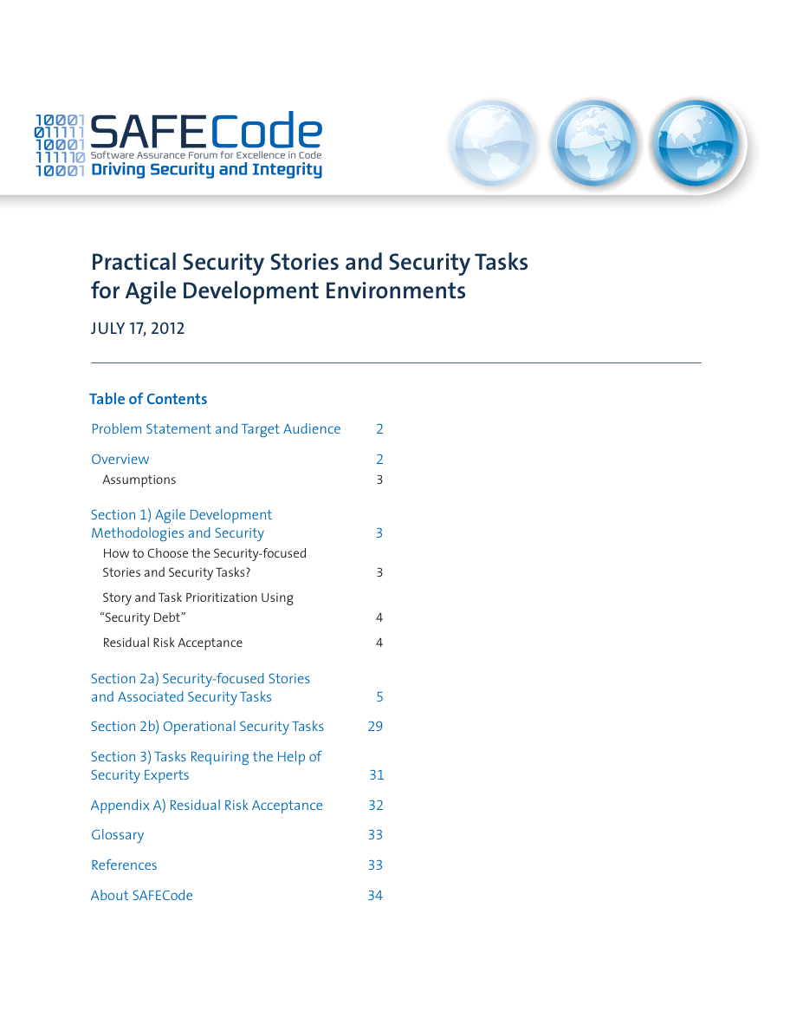
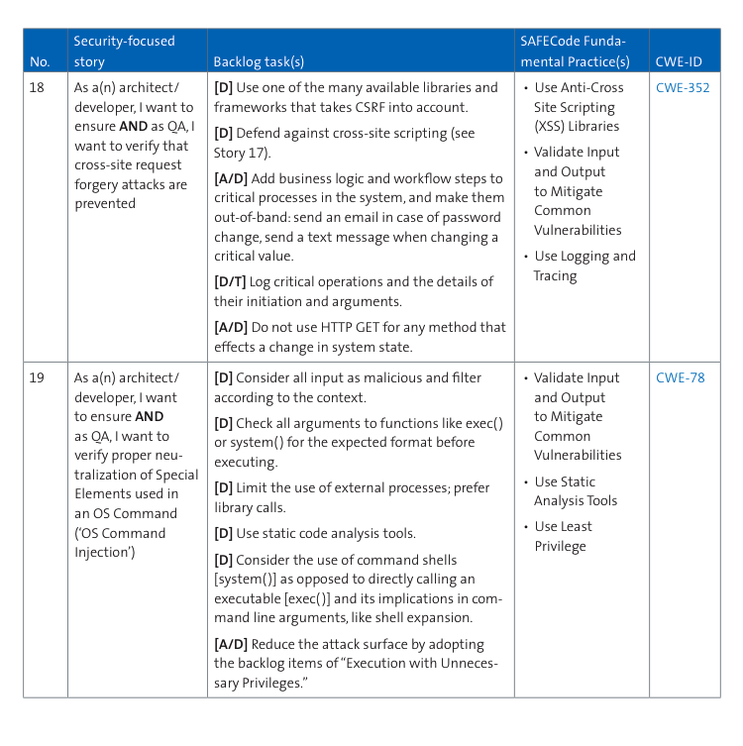
SAFECode - Practical Security Stories and Security Tasks for Agile Development Environments

Slide 3
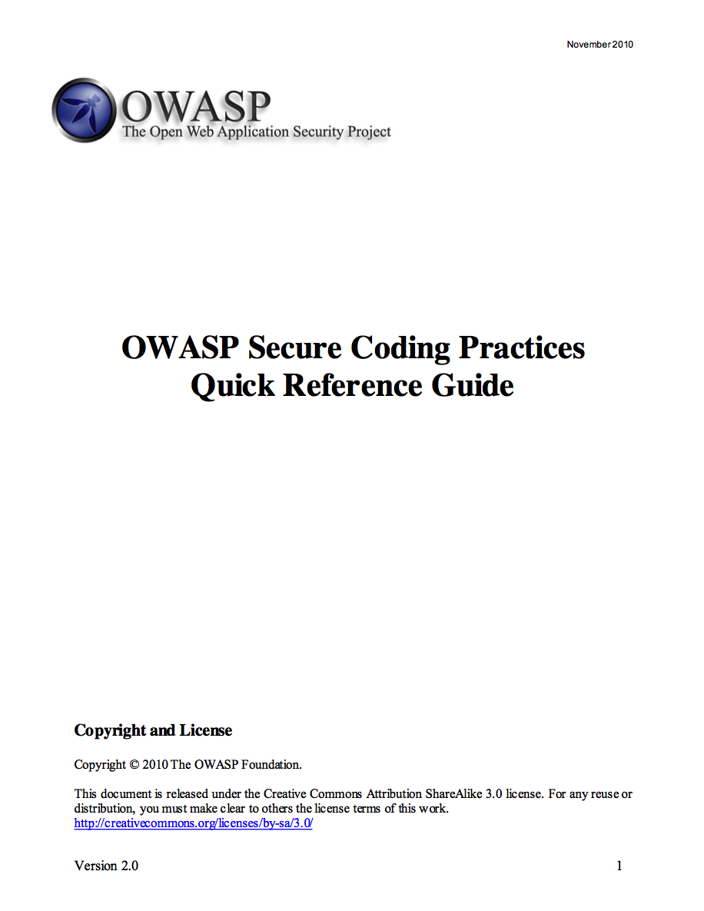
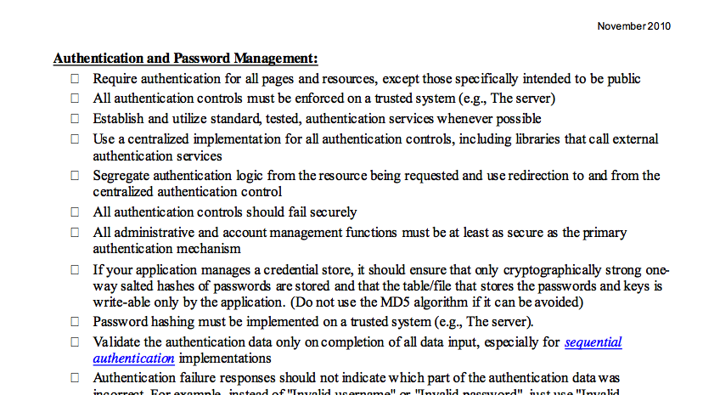
OWASP Secure Coding Practices – Quick Reference Guide
https://www.owasp.org/index.php/OWASP_Secure_Coding_Practices_-_Quick_Reference_Guide

Slide 4
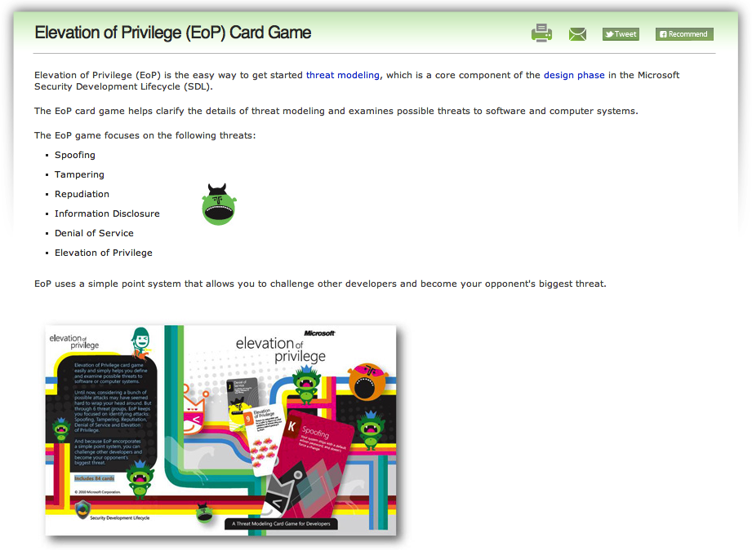
Microsoft Elevation of Privilege (EoP) Card Game
http://www.microsoft.com/security/sdl/adopt/eop.aspx

Slide 5
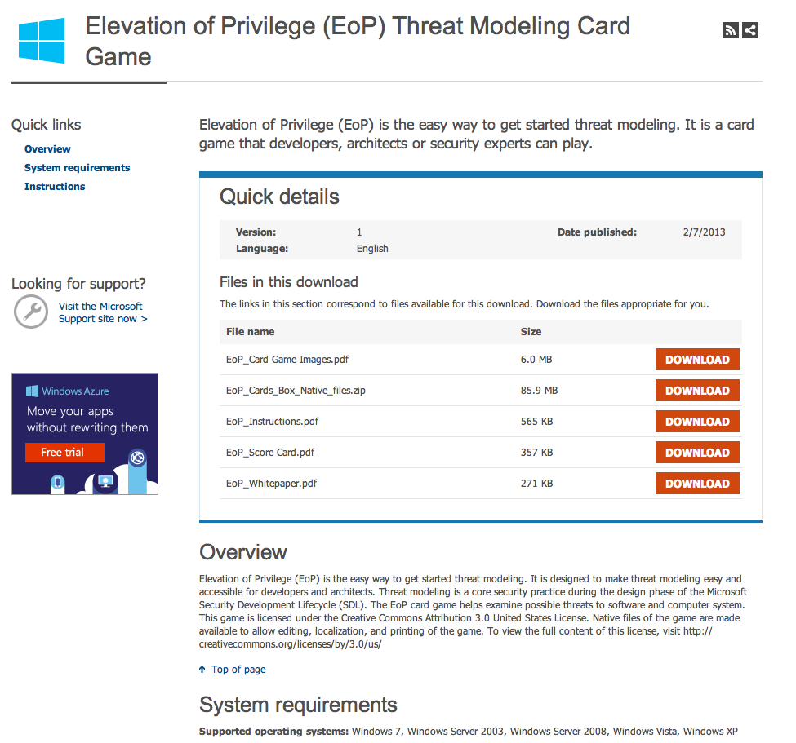
Downloads for EoP
http://www.microsoft.com/en-us/download/details.aspx?id=20303

Slide 6
More web application relevant
ü
EoP examples
An attacker could squat on the random port or socket that the server normally uses
An attacker can confuse a client because there are too many ways to identify a server
An attacker can make [your authentication system|client|server] unusable or unavailable [without ever authenticating] [but the problem goes away when the attacker stops|and the problem persists after the attacker goes away] (10 cards)
An attacker can provide a pointer across a trust boundary, rather than data which can be validated
Cornucopia examples
Gary can take over a user's session because there is a long or no inactivity timeout, or a long or no overall session time limit, or the same session can be used from more than one device/location
Marce can forge requests because per-session, or per-request for more critical actions, strong random tokens or similar are not being used for actions that change state
Eduardo can access data he does not have permission to, even though he has permission to the form/page/URL/entry point

Slide 7
More coverage of web security requirements
ü
EoP suits = STRIDE
Spoofing
Impersonating something or someone else
Tampering
Modifying data or code
Repudiation
Claiming to have not performed an action
Information Disclosure
Exposing information to someone not authorized to see it
Denial of Service
Deny or degrade service to users Elevation of Privilege Gain capabilities without proper authorization
Cornucopia suits
Data validation and encoding
Input and output data validation and escaping
Authentication
Verification of identity claims and related processes
Session management
Maintenance of user state
Authorization
User/role permission controls
Cryptography
Hashing, digital signatures, encryption and random number generation processes and their usage including key management
Cornucopia (everything else)
Including information leakage, data loss, dependencies, abuse of trust, non-repudiation, configuration management, function misuse, denial of service
http://STRIDE

Slide 8
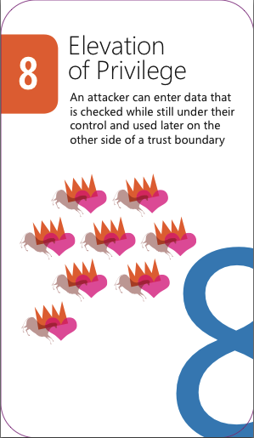

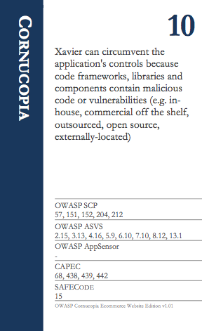
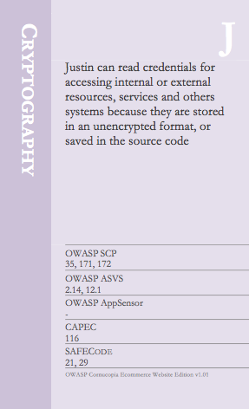


Less colourful and less pictorial
û
ü
EoP playing cards
Cornucopia playing cards

Slide 9
Less vendor specific and more webapp/OWASP specific
ü
EoP examples
An attacker could take advantage of .NET permissions you ask for, but don’t use
An attacker can alter information in a data store because it has weak ACLs or includes a group which is equivalent to everyone (“all LIve ID holders”)
Cornucopia examples
Bob can influence, alter or affect the application so that it no longer complies with legal, regulatory, contractual or other organizational mandates
You have invented a new attack of any type
  Read more about application security in OWASP’s free Guides on Requirements, Development, Code Review and Testing, the Cheat Sheet series, and the Open Software Assurance Maturity Model
You have invented a new attack against Authorization
  Read more about this topic in OWASP’s Development and Testing Guides

Slide 10
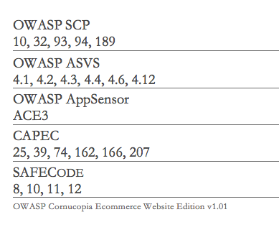
More information rich
ü
EoP
Suit name (e.g. Denial of Service)
Attack description
Ranking (card number)
Cornucopia
Suit name (e.g. Authentication)
Attack description
Ranking (card number)
Cross-referencing
Security requirements, security verification checks, attack detection points, attack patterns and Agile user stories

Slide 11
More individual
ü
EoP
An attacker could steal credentials stored on the server and reuse them (for example, a key is stored in a world readable file)
An attacker can manipulate data because there’s no integrity protection for data on the network
An attacker can provide or control state information
An attacker can say “I didn’t do that,” and you’d have no way to prove them wrong
Cornucopia
Shamun can bypass input validation or output validation checks because validation failures are not rejected or sanitized
Kyun can access data because it has been obfuscated rather than using an approved cryptographic function
Keith can perform an action and it is not possible to attribute it to him

Slide 12
What's in a name?
ü
The “names” can represent
External or internal people
Aliases for computer system components
  The application itself
  Other applications
  Services
  Operating systems
  Infrastructure
Jim can undertake malicious, non-normal, actions without real-time detection and response by the application

Slide 13
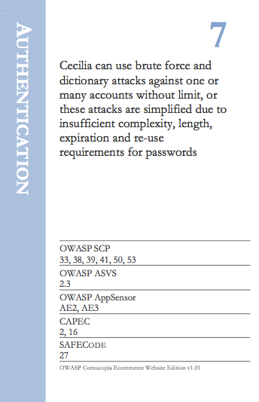
Identifying requirements with each card played
Suit and value
Attack description
Cross-referencing
Is this a viable attack for the function/system under consideration?
Document the attack
Subsequently use the cross-references to help create security requirements:
  User stories
  Unit tests
  Configurations
  etc

Slide 14
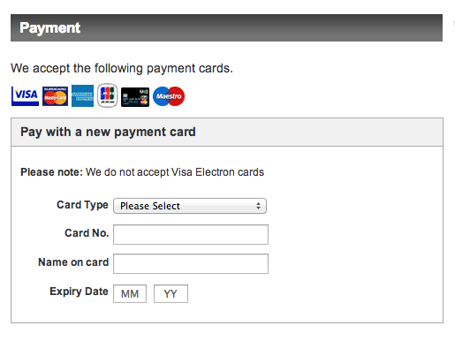
Example: Third party hosted payment form 1/3
Common e-commerce implementations
Merchant-managed e-commerce implementations
  Proprietary/custom developed shopping cart/payment application
  Commercial shopping cart/payment application
Shared-management e-commerce implementations
  Third-party embedded application programming interfaces (APIs) with Direct Post
  An inline frame (or “iFrame”) that allows a payment form hosted by a third party to be embedded within the merchant’s page(s)
  Third-party hosted payment page which redirects the consumer to a page on an entirely different domain for payment entry
Wholly outsourced e-commerce implementations

Slide 15
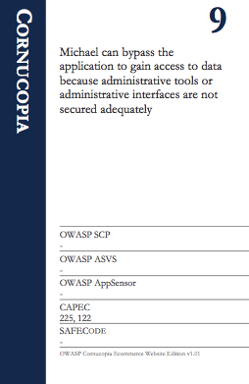
Example: Third party hosted payment form 2/3
The template used at the third party could be modified by an attacker

Slide 16
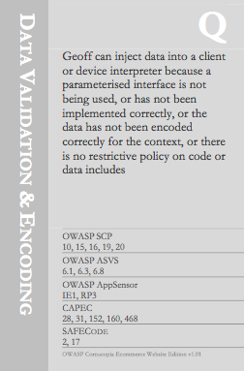
Example: Third party hosted payment form 3/3
Content on the page is included from a less trusted source
  JavaScript
  CSS
  Images
Another third party (e.g. metrics, hosted JavaScript library)
First party (i.e. merchant)

Slide 17
Deal the deck of cards
Erik
Ferdinand
Outcomes:
Players have the same number of cards each
Randomly select one player to lead the play for the first round
e.g. Ferdinand
10
J
9
8
4
K
5
7
8
J
A
Q
7
A
9
10
4
8
2
2
Imogen
Martin

Slide 18
Let play commence – First round
1
0
Requirements
Rounds
1
1
Requirements
Rounds
0
0
0
0
10
7
8
7
3
J
K
J
A
8
Schedule of requirements
Erik
Ferdinand
Assume every player Except “Imogen” identified a security requirement, thus 1 point each for the others
“Ferdinand” won the round with the King so he gets an additional 1 point, and leads the play for the next round
Imogen
Martin
8
4
Q
9
2
9
5
A
10
2
0
0
Requirements
Rounds
0
0
Requirements
Rounds
1
0
0
0

Slide 19
Second round
1
0
Requirements
Rounds
2
1
Requirements
Rounds
1
0
1
1
10
7
7
3
J
J
A
8
Schedule of requirements
Erik
Ferdinand
Only “Ferdinand” and “Imogen” identified new requirements and they each receive 1 point
“Martin” won the round with the Ace so he gets 1 point for that, and leads the play for the next round
Imogen
Martin
8
4
Q
9
9
5
A
2
1
0
1
0
Requirements
Rounds
0
0
Requirements
Rounds
1
1

Slide 20
Third round
2
0
Requirements
Rounds
3
1
Requirements
Rounds
1
0
2
1
10
7
7
J
A
8
Schedule of requirements
Erik
Ferdinand
Everyone identified new requirements and they each receive 1 point
“Imogen” won the round with the Queen so she gets 1 point for that, and leads the play for the next round
Imogen
Martin
8
Q
9
9
5
2
1
1
Requirements
Rounds
2
1
Requirements
Rounds
2
1
1
0

Slide 21
Fourth round
3
0
Requirements
Rounds
4
2
Requirements
Rounds
2
0
3
1
10
7
J
A
Schedule of requirements
Erik
Ferdinand
Everyone identified new requirements and they again each receive 1 point
“Ferdinand” won the round with the Jack so he gets 1 point for that, and leads the play for the final round – he also has the most points so far
Schedule of requirements
Imogen
Martin
8
9
5
2
2
1
Requirements
Rounds
3
1
Requirements
Rounds
3
1
2
1

Slide 22
Fifth and final round
3
0
Requirements
Rounds
5
2
Requirements
Rounds
3
0
4
2
10
A
Schedule of requirements
Erik
Ferdinand
Everyone except “Erik” identified new requirements and they each receive 1 point
“Imogen” won the round with the 8 (trumps) so she gets 1 point for that
Overall Ferdinand wins the game with a total of 7 points
Schedule of requirements
Imogen
Martin
8
2
3
1
Requirements
Rounds
4
2
Requirements
Rounds
4
1
3
1

Slide 23
Choose your deck of cards
Cornucopia suits
Data validation and encoding
Input and output data validation and escaping
Authentication
Verification of identity claims and related processes
Session management
Maintenance of user state
Authorization
User/role permission controls
Cryptography
Hashing, digital signatures, encryption and random number generation processes and their usage including key management
Cornucopia (everything else)
Everything else including information leakage, data loss, configuration management, denial of service
Full deck

Slide 24
Application-specific decks
Cornucopia suits
Data validation and encoding
Input and output data validation and escaping
Authentication
Verification of identity claims and related processes
Session management
Maintenance of user state
Authorization
User/role permission controls
Cryptography
Hashing, digital signatures, encryption and random number generation processes and their usage including key management
Cornucopia (everything else)
Everything else including information leakage, data loss, configuration management, denial of service
Public information website
f
Extranet

Slide 25
Development-specific decks
Cornucopia suits
Data validation and encoding
Input and output data validation and escaping
Authentication
Verification of identity claims and related processes
Session management
Maintenance of user state
Authorization
User/role permission controls
Cryptography
Hashing, digital signatures, encryption and random number generation processes and their usage including key management
Cornucopia (everything else)
Everything else including information leakage, data loss, configuration management, denial of service
Organisation's coding and configuration standards
or
Compliance requirements (e.g. PCIDSS)
Framework X

Slide 26
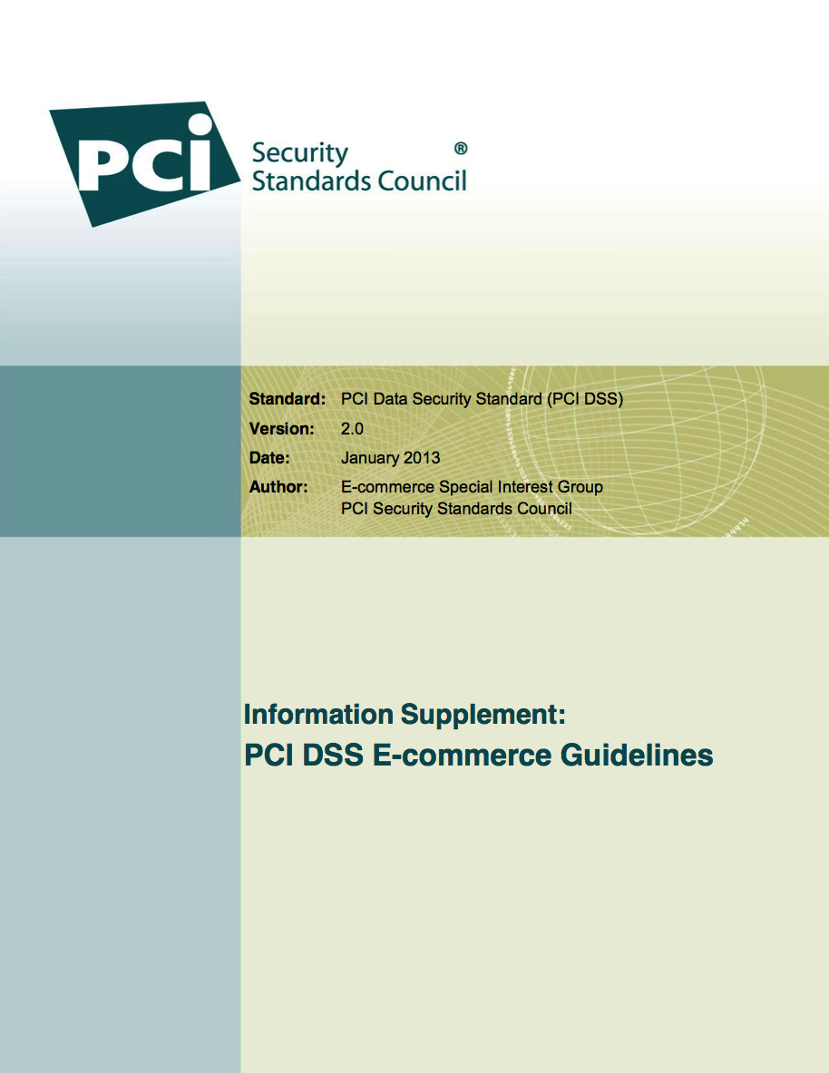
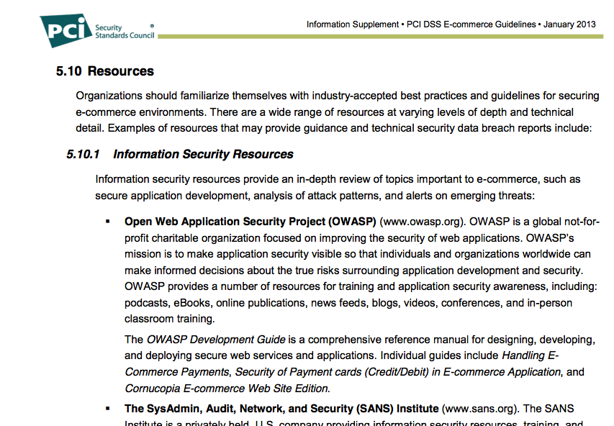
Does Cornucopia matter?

Slide 27
Project plan
Improvements
Complete framework-specific card decks
Enhance text and mappings
Further developer feedback
Issue further releases
Graphical design
Printing and distribution
Other editions
(Ecommerce website)
Web services
Mobile app
Smart meter

Slide 28
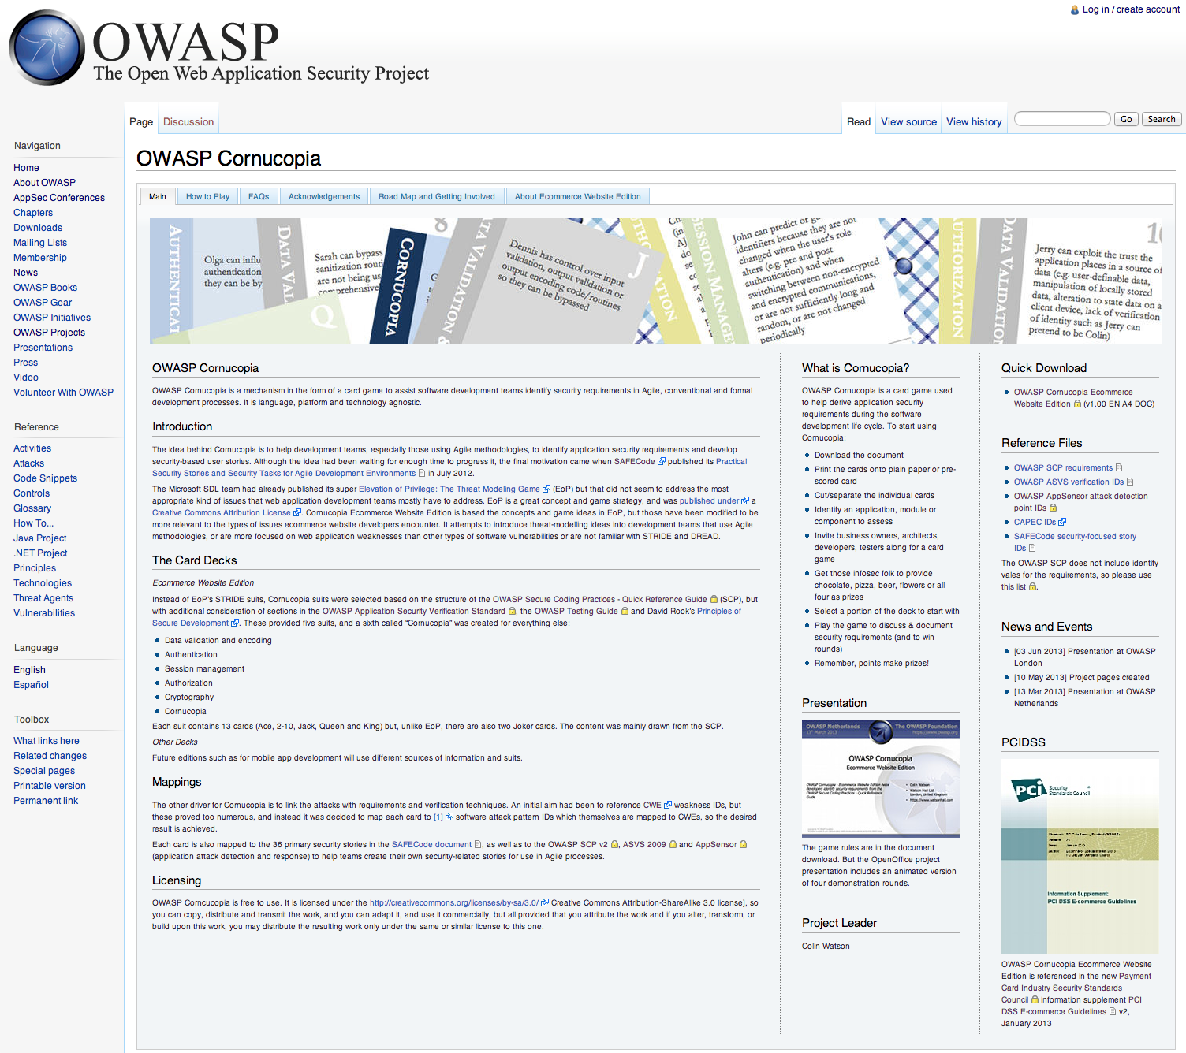
Project on the OWASP wiki
https://www.owasp.org/index.php/OWASP_Cornucopia

Slide 29
The project
OWASP Cornucopia
https://www.owasp.org/index.php/OWASP_Cornucopia
https://lists.owasp.org/mailman/listinfo/owasp_cornucopia
Download Cornucopia Ecommece Website Edition v1.00
https://www.owasp.org/index.php/File:OWASP-Cornucopia-Ecommerce_Website.docx
Colin Watson
colin.watson(at)owasp.org

